Slide 1
Introduction to Python
Class 6

Slide 2
Resources
eBook
Hard Copy book
Visualizing Code tool
Cheat Sheets
*Control click to go to the link.

Slide 3
Timeline
2/16/19 – Functions
2/23/19 – reading/writing to text files and csv files
3/2/2019 – Final review and modules (pandas, numpy)
Revised timeline.
Feedback?

Slide 4
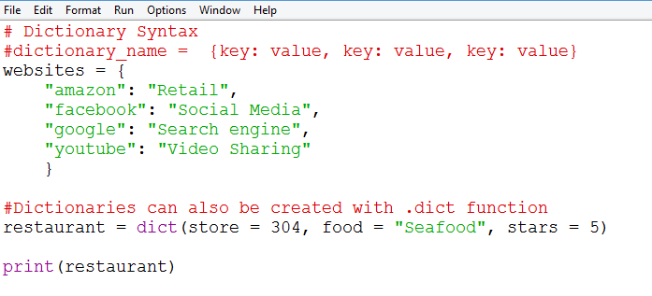
Review: Creating a dictionary
Notes:
# Dictionary Syntax
#dictionary_name = {key: value, key: value, key: value}
websites = {
"amazon": "Retail",
"facebook": "Social Media",
"google": "Search engine",
"youtube": "Video Sharing"
}
#Dictionaries can also be created with .dict function
restaurant = dict(store = 304, food = "Seafood", stars = 5)
print(restaurant)

Slide 5
Review Math operators
Operator | Name | Syntax | Output
abs() | Absolute Value | Abs(-4) | 4
round() | Round | round(3.14152,2) | 3.14
// | Floor division. Returning an integer rounded down. | 10//3 | 3
** | Exponent | 10**2 | 100
% | Modulo. Returns the remainder | 11%2 | 1
Notes:
Review from powerpoint 2 slide 4. We will be using exponents in this lesson

Slide 6
Review: String Methods
Operator | Purpose | Input | Syntax | Output
.upper() | Converts to Upper Case | name = “Monty” | name.upper() | MONTY
.lower() | Converts to lower case | name = “Monty” | name.lower() | monty
.title() | Converts to Title case | name = “monty” | name.title() | Monty
.replace() | Replaces parts of a string | s = “I like my dogs” | s.replace(“like”,”love”) | I love my dogs
Python is case sensitive. “Monty” != “MONTY”
Notes:
Review from powerpoint 2 slide 10

Slide 7
Review:
function
argument
print(“Hello”)
print(len(“hello”))
int(input(“How old are you?”))
Notes:
The argument is a value that is passed through the function.
Some functions require arguments, some do not take any arguments, and some have optional arguments

Slide 8
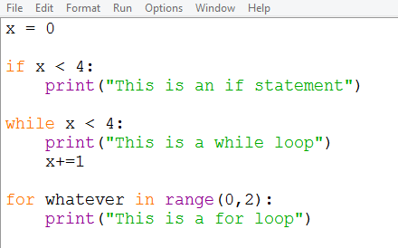
Syntax Review
Control statement
condition followed by colon
Indentation
Notes:
x = 0
if x < 4:
print("This is an if statement")
while x < 4:
print("This is a while loop")
x+=1
for whatever in range(0,2):
print("This is a for loop")

Slide 9
Review: Methods vs functions
So far we have worked with functions like print(x) and len(number)
Those functions should be in purple font when typed in the default IDE
Methods are types of functions but are attached to an object (like a library or list)
Methods do not change color in the IDE like functions do
Methods take on the following format:
object
method
arguments
random.randint(1,6)

Slide 10
Review:
object
method
arguments
random.randint(1,6)
my_dictionary.get(“sugar” )
my_list.append(“milk”)
my_name.upper()
Notes:
random.randint(1,6)
Object is the random library.
Method is randint. Other methods include .choice and random.shuffle()
Other objects include dictionaries, lists,

Slide 11
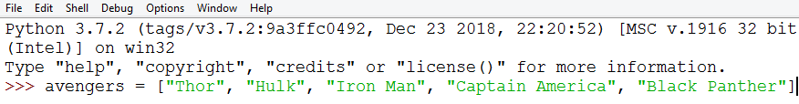
Review: Retrieving Data from a list
Index 0 1 2 3 4
Neg index -5 -4 -3 -2 -1
Syntax | Description | Output
print(avengers[2]) | Will print index 2 | Iron man
print(avengers[0:3]) | Prints index 0, 1, and 2 | [‘Thor', ‘Hulk', 'iron man']
print(avengers[-3:]) | Prints index-3 and everything to the right of it | ['Iron Man', 'Captain America', 'Black Panther']
print(avengers[-4:-2]) | Prints index -4 and -3. it stops at -2 | [‘Hulk', ‘Iron man’]

Slide 12
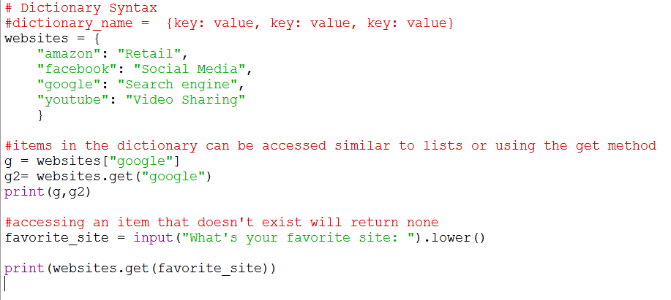
Review: Retrieving data in a dictionary
Notes:
# Dictionary Syntax
#dictionary_name = {key: value, key: value, key: value}
websites = {
"amazon": "Retail",
"facebook": "Social Media",
"google": "Search engine",
"youtube": "Video Sharing"
}
#items in the dictionary can be accessed similar to lists or using the get method
g = websites["google"]
g2= websites.get("google")
print(g,g2)
#accessing an item that doesn't exist will return none
favorite_site = input("What's your favorite site: ").lower()
print(websites.get(favorite_site))

Slide 13
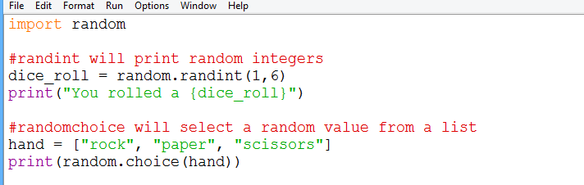
Review: Random library
The random library is pre-built
Use syntax: random.methodname(arguments)

Slide 14
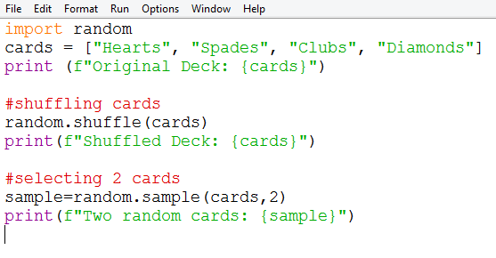
Random Library Methods
The random library has additional methods.
See Python directory in IDE or Python website for full list of methods
Notes:
https://docs.python.org/3/library/random.html

Slide 15
Functions
Functions are code blocks that perform certain tasks
We have been using built-in functions like print() and len() and sum()
Python also allows you to create your own.
Like loops, functions allow you to re-use your code and help improve the readability of your code and speed/size/efficiency.
Functions save time and energy for you and other programmers
Notes:
Cheat sheet of built in functionshttps://docs.python.org/3/library/functions.html#min

Slide 16
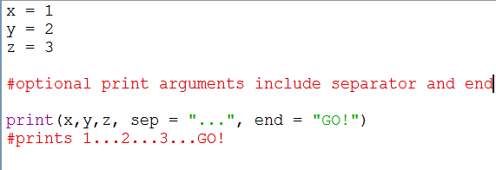
Functions
Before creating our function, lets take a closer look at functions we’re already familiar with: The print function
You can look at the arguments of the print function by running the code print(print.__doc__) or going to the Python documentation website
Some functions like len function takes exactly one argument and it is required while others take no arguments
Notes:
https://docs.python.org/3/library/functions.html

Slide 17
Functions
Functions have default values which we can override.
In the print function, when you don’t specify any value for separator the default is a space.
When you don’t specify a value for end, the default behavior is a new line
Notes:
x = 1
y = 2
z = 3
#optional arguments include separator and end
print(x, y, z, sep = "...", end = "GO!")
#prints 1...2...3...GO!
#Another example is the .pop method. If you don’t enter anything in the parenthesis, it will pop the last value but if you enter pop(3) it will pop the 3rd index

Slide 18
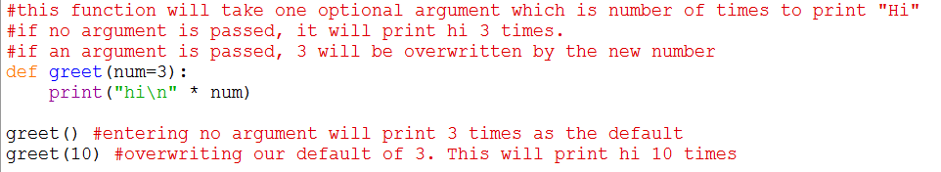
Functions
To specify a default value, simply set it as an equal sign.
This default can be updated later
Notes:
#syntax
#def function_name(arguments):
#what the function does
#this function will take no arguments. it will simply print hello 4 times
def hello():
print("Hello\n"*5)
#this function will take one required argument which is number of times to print "Hi"
def hi(num):
print("hi\n"*num)
#Call the function you created the same way you call pre-built functions
hello() #will print hello 5 times
hi(20) #will print hi 20 times

Slide 19
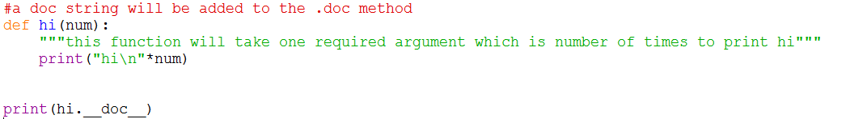
Doc String
To add a doc string, use triple double quotes
Notes:
#a doc string will be added to the .doc method
def hi(num):
"""this function will take one required argument which is number of times to print hi"""
print("hi\n"*num)
print(hi.__doc__)

Slide 20
Exercises #1
1.1 Create a function called yell(“string”) which prints out the argument in all caps and adds six exclamation points at the end
1.2 Create a function called calculate which requires you to pass in 2 numbers and prints their sum, product, difference, and quotient
1.3 Create a function called exponent which has 2 parameters. The base will be required with no default value. The power will be optional with a default value of 2
Base will be a required argument
Power will be an optional argument with default value of 2
5²= 5x5

Slide 21
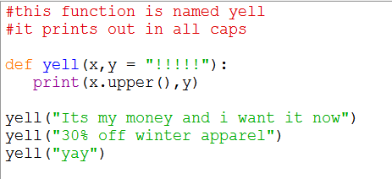
Solution 1.1
1.1 Create a function called yell(“some_string”) which prints out whatever is in parenthesis in all caps and adds six exclamation points at the end
Notes:
#syntax
#def function_name(arguments):
#what the function does
#this function will take no arguments. it will simply print hello 5 times
def yell(x,y = "!!!!!"):
print(x.upper(),y)
yell("Its my money and i want it now")

Slide 22
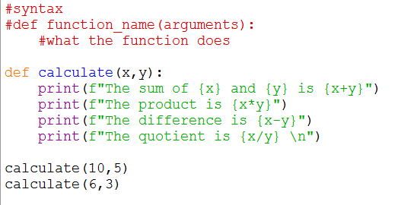
Solution 1.2
1.2 Create a function that takes 2 numbers and prints their sum, product, difference, and quotient
Notes:
#syntax
#def function_name(arguments):
#what the function does
#this function will take no arguments. it will simply print hello 5 times
def calculate(x,y):
print(f"sum {x+y}")
print(f"product is {x*y}")
print(f"difference is {x-y}")
print(f"quotient is {x/y}")
calculate(10,5)

Slide 23
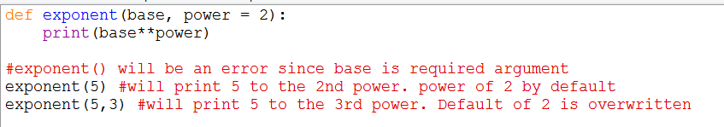
Solution 1.3
Create a function called exponent which has 2 parameters. The base will be required with no default value. The power will be optional with a default value of 2
Notes:
def exponent(base, power = 2):
print(base**power)
#exponent() will be an error since base is required argument
exponent(5) #will print 5 to the 2nd power. power of 2 by default
exponent(5,3) #will print 5 to the 3rd power. Default of 2 is overwritten

Slide 24
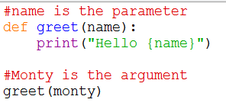
Parameters vs arguments
Parameters and arguments are sometimes used interchangeably but they are different
A parameter is the variable name declared in the definition
An argument is the data we pass into those parameters
Notes:
Cheat sheet of built in functions https://docs.python.org/3/library/functions.html#min

Slide 25
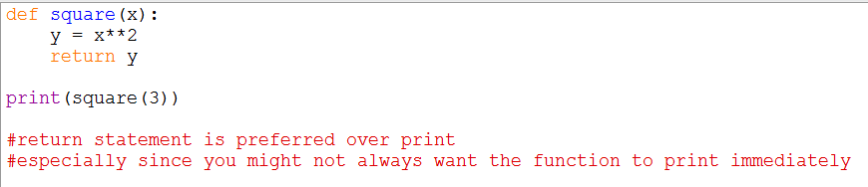
Return
So far we have used the print statement instead of return
The return statement stores the result but does not print

Slide 26
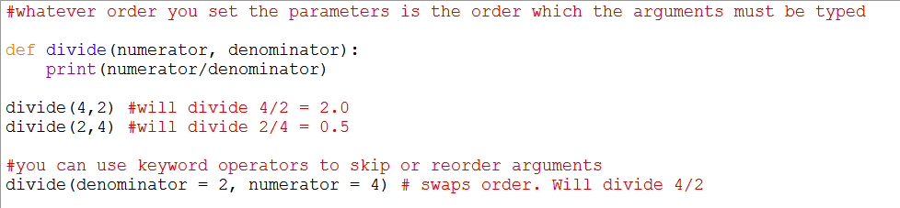
Keyword Argument
Functions can take an infinite number of parameters
Using keyword arguments can help clarify what arguments you are passing by explicitly stating each argument and can save time by skipping optional arguments
Notes:
#whatever order you set the parameters is the order which the arguments must be typed
def divide(numerator, denominator):
print(numerator/denominator)
divide(4,2) #will divide 4/2 = 2.0
divide(2,4) #will divide 2/4 = 0.5

Slide 27

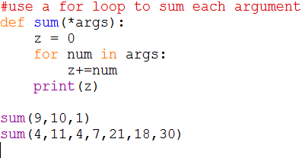
*Args
Although we said functions can take an unlimited number of arguments, there is amore efficient way to write something like this
If we want the function to add numbers together but the number of arguments will vary, use *args

Slide 28
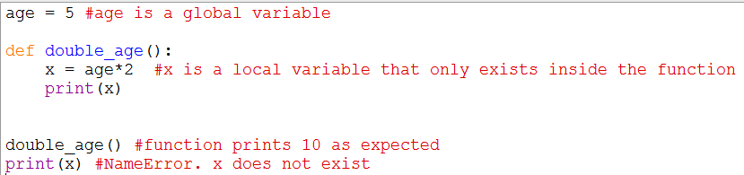
Scoping
Variables in python can only be accessed and manipulated only in certain parts of the code.

Slide 29
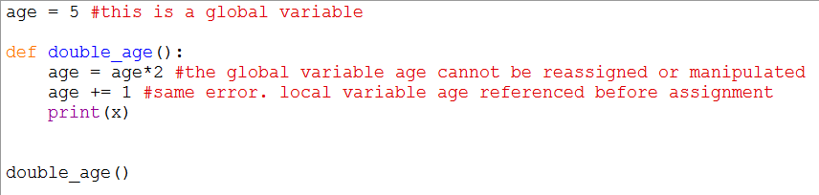
Scoping
Variables in python can only be accessed and manipulated only in certain parts of the code.
Notes:
age = 5 #this is a global variable
def double_age():
age = age*2 #the global variable age cannot be reassigned or manipulated
age += 1 #same error. local variable age referenced before assignment
print(x)
double_age()

Slide 30
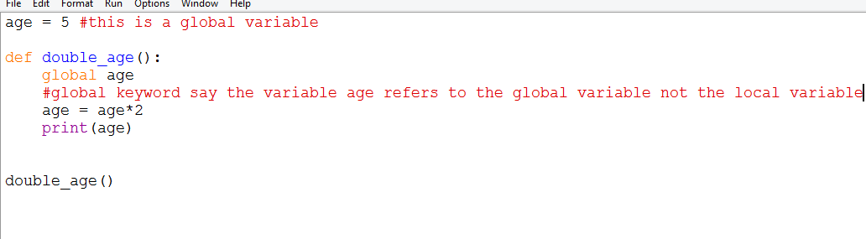
Scoping
You can use the global keyword to change the scope
Notes:
age = 5 #this is a global variable
def double_age():
global age
#global keyword say the variable age refers to the global variable not the local variable
age = age*2
print(age)
double_age()

